Slide 1

ReactJS
By Mycos Technologies

Slide 2



Mycos Technologies Company
Today's
Agenda
1
Intro Html/CSS/JS/TS
2
Basic React
3
Component/Event/State
4
Create the GAME!

Slide 3

Course Timeline
HTML/CSS
Javascript
Typescript
ReactJS
GAME TIME

Slide 4

Prerequisites/Tools/ Environments
NodeJS – v.16.15.0
NPM 8.5.5
VS Code
Git (optional)
Postman (optional)

Slide 5

Intro Html,CSS, JavaScript,TypeScript

Slide 6

HTML/CSS
What is HTML?
HTML Document Structure
Example HTML tags
Headings and Paragraphs
Text formatting
Links / Image
What is CSS?
Applying CSS in HTML document

Slide 7
What is HTML?
HyperText Markup Language
Language to define layout, content for website
Important terms
Element / Tag
Attribute

Slide 8
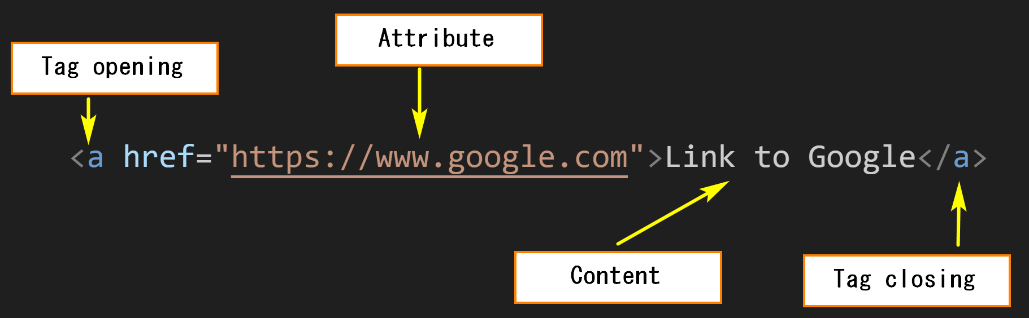
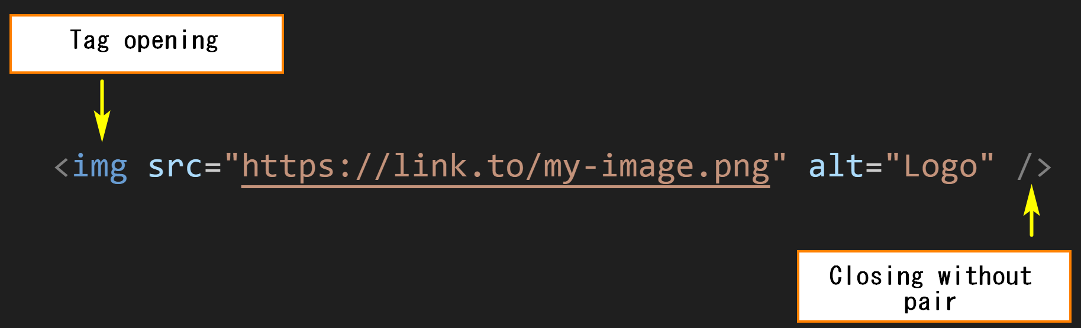
Tag / Element

Slide 9
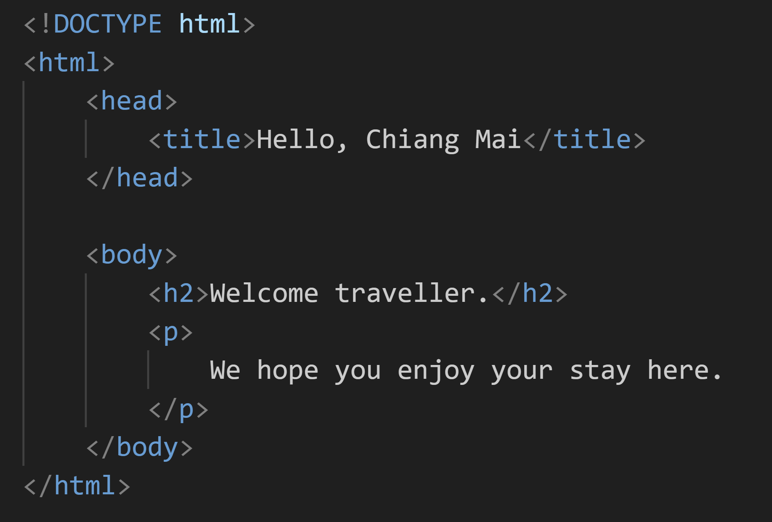
HTML Structure

Slide 10
Example: heading/paragraph
Using tag <h1>, <h2>, ..., <h6> to define heading
Using tag <p> to define paragraph
Using tag <br /> to line-breaking

Slide 11

Example: Text Formatting
<b> - Bold text
<strong> - Important text
<i> - Italic text
<em> - Emphasized text
<mark> - Marked text
<small> - Smaller text
<del> - Deleted text
<ins> - Inserted text
<sub> - Subscript text
<sup> - Superscript text

Slide 12
Example: Link / Image
<img /> - Insert image
`src` to specify source of image
<a>...</a> - Insert Link
`href` to specify target URL

Slide 13
What is CSS?
Cascading style sheets
Describes how HTML elements are to be displayed on screen
Control the layout of multiple web pages all at once
Can be stored in seperated CSS files
Types
Inline
Pre-defined CSS

Slide 14
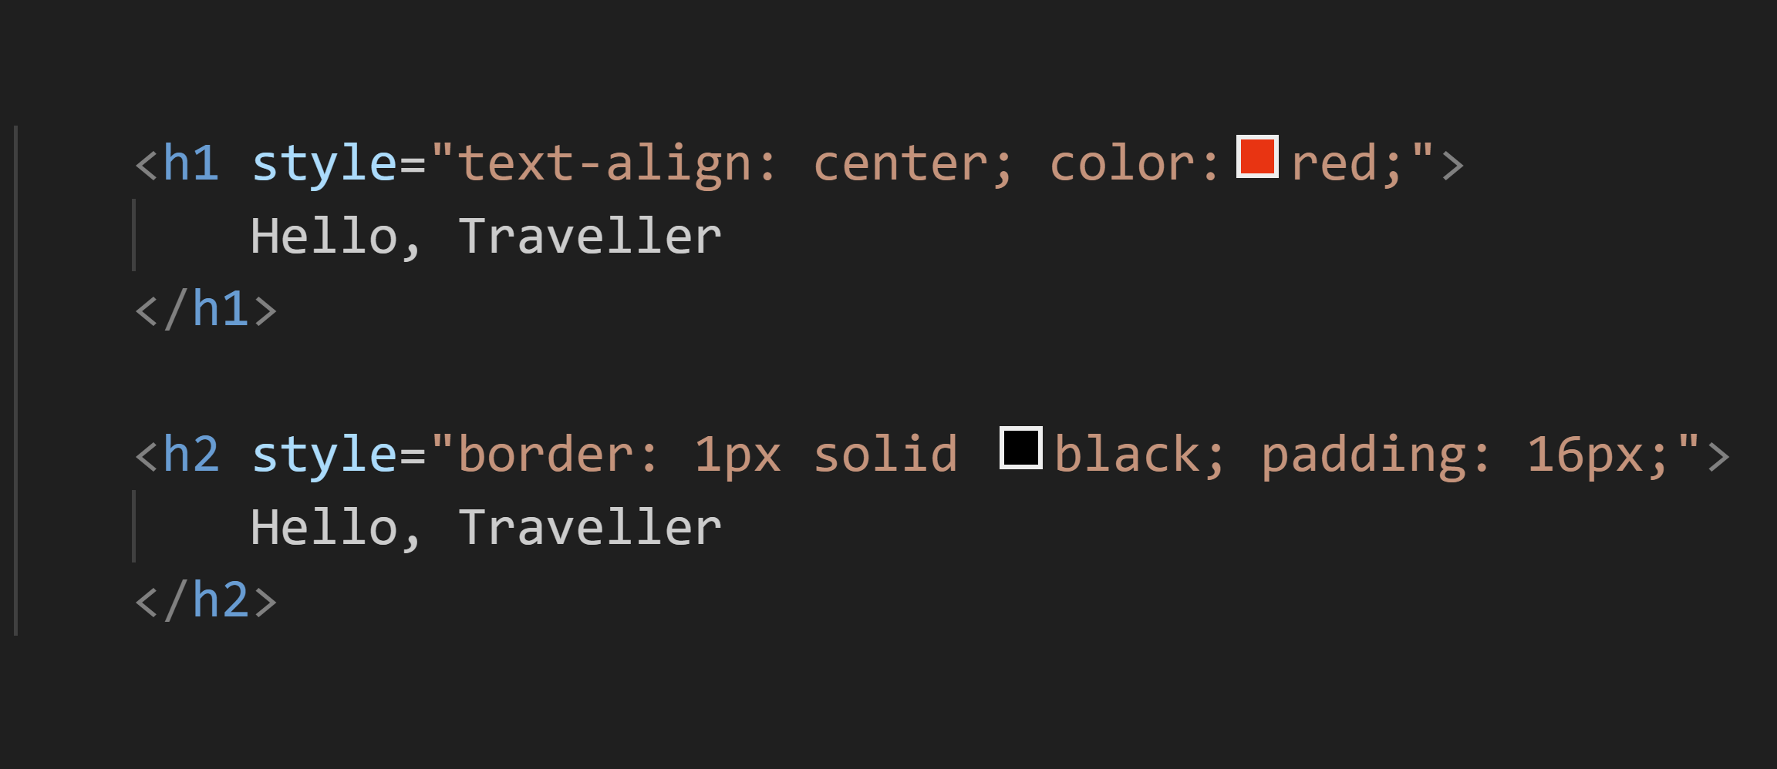
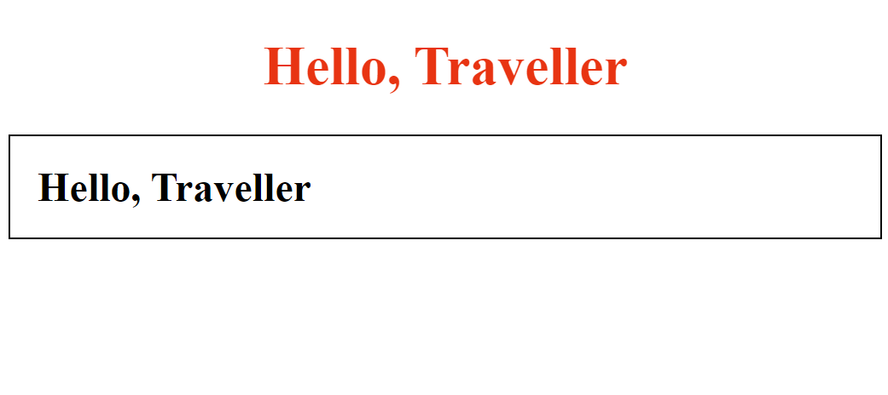
Example: Inline CSS

Slide 15
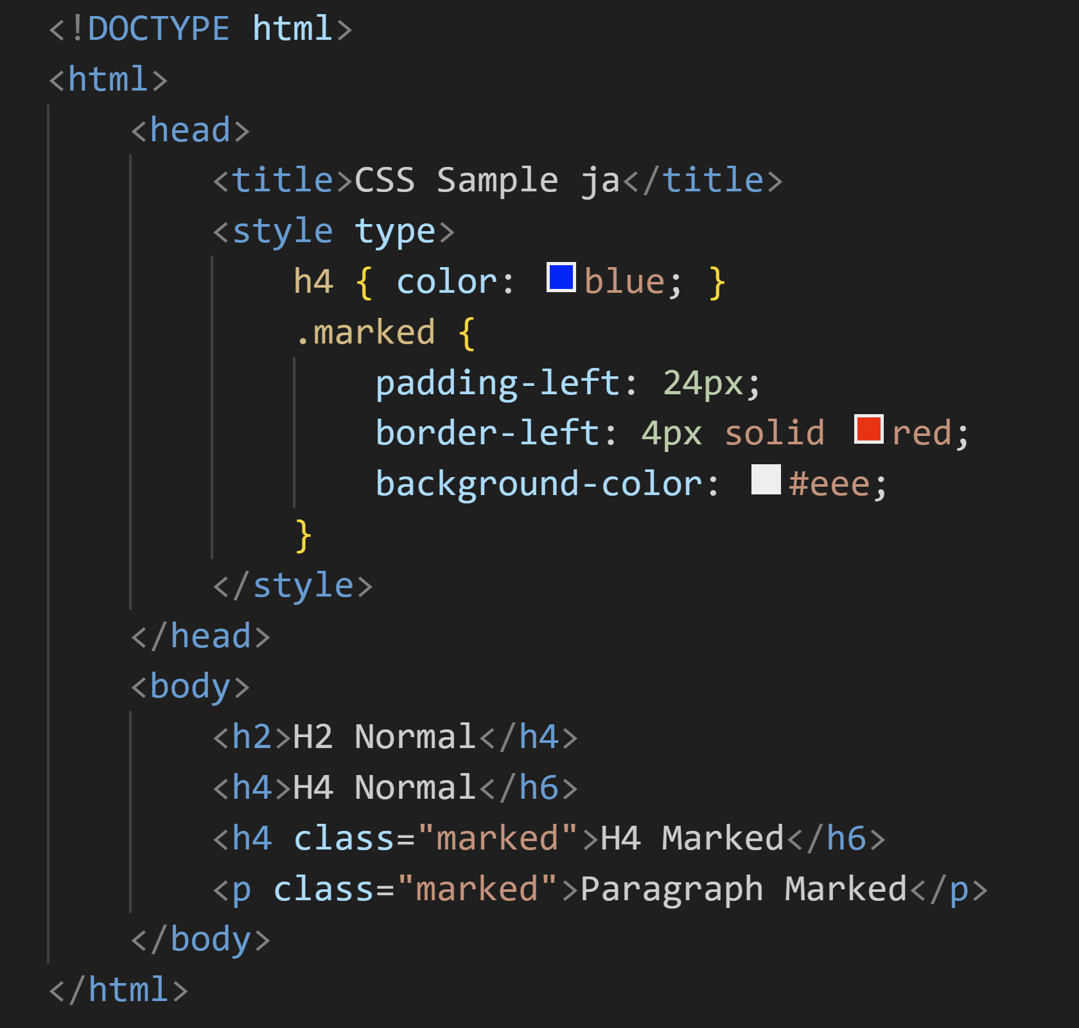
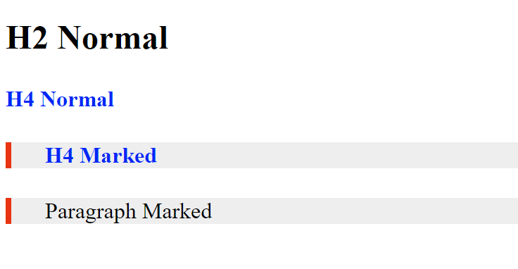
Example: Pre-defined CSS

Slide 16
JavaScript
HTML: Web Structure
CSS: Theming
Javascript
"Interactive & Business Logic"

Slide 17
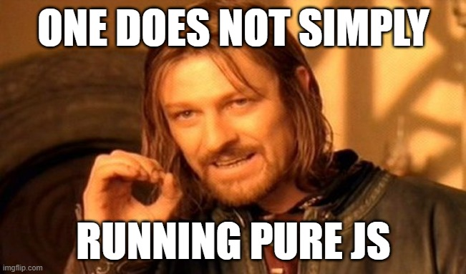
Prepare testing workspace

Slide 18
Hello, world
alert(): show message box
console.log(): show message in console
prompt(): show input dialog

Slide 19
Data Types
Primitive types: number, string, boolean
Object type: array, object
To define
Use `const` for immutable data
Use `let` for mutable data
Use `typeof` keyword to return data type

Slide 20
String Type
Immutable (read only)
Common function
indexOf()
subString()
toLowerCase(), toUpperCase()
trim()
String interpolation

Slide 21
Code Comment
// for one line comment
/* */ for multi line comment
In VSCode, use Ctrl + '/' as shortcut

Slide 22

Operator
Arithmetic operator: + - * / % ++ --
Bitwise operator: & | ^ << >>
Assignment operator: = += -=
Comparison: == != === !==
3 == '3'
3 !== '3'

Slide 23
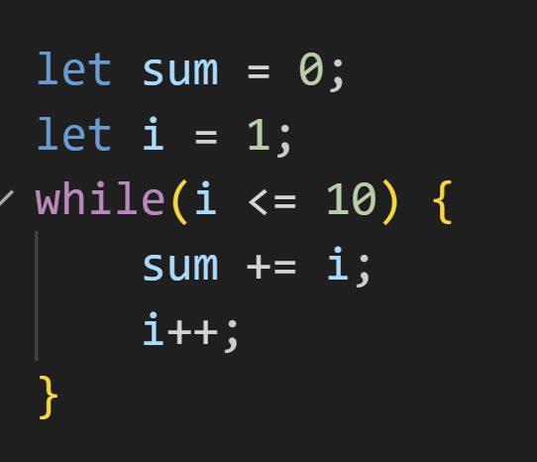
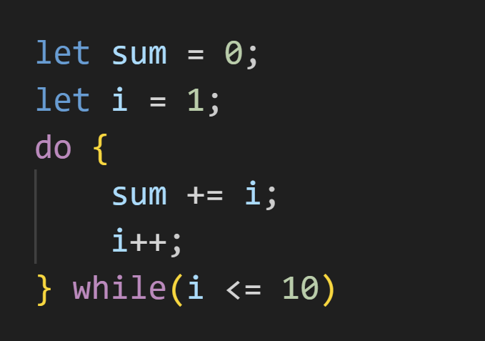
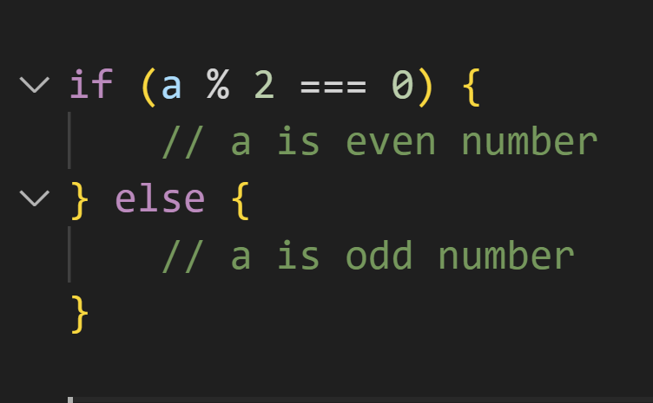
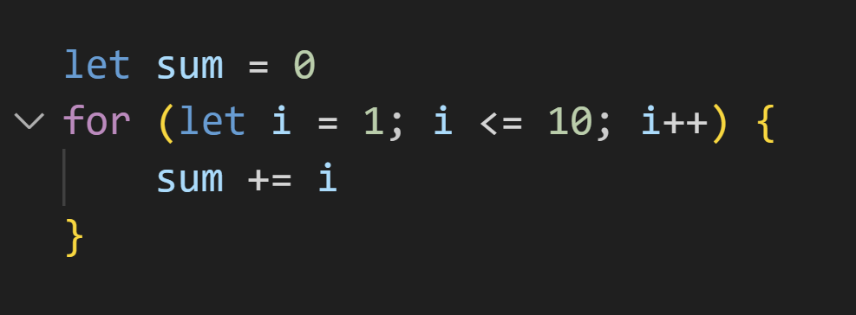
Control Flow
If - else
Do-while
While
For

Slide 24

Quiz
Check whether X is prime number

Slide 25
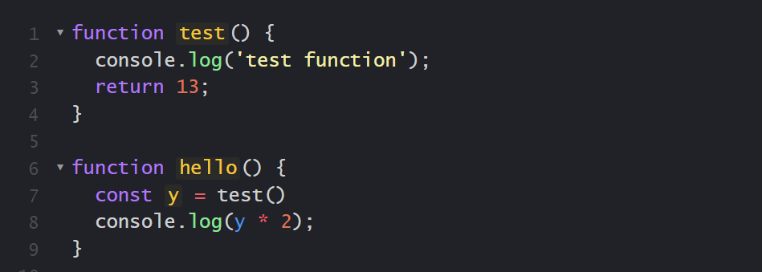
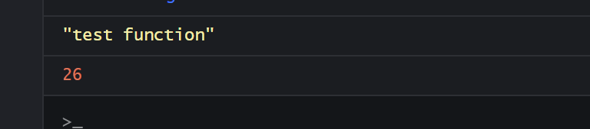
Function
Keyword 'function'

Slide 26
Array
Collection of data
Inline define in bracket [] with comma (,) as seperator
Access element in array by [index]
Get array size by property 'length'

Slide 27
push / pop / shift / unshift
push() / pop(): add or remove element from end of array
unshift() / shift(): add or remove element from beginning of array

Slide 28
arrA.concat(arrB)
concatinate two array
return new array

Slide 29
slice(start, end)
extract part of array, return new array
has 2 parameters (start, end)
`end` is optional parameter

Slide 30
splice(start, deleteCount, ...items)
Use to delete or insert items to `start` at the same time
Return removed elements as a new array

Slide 31
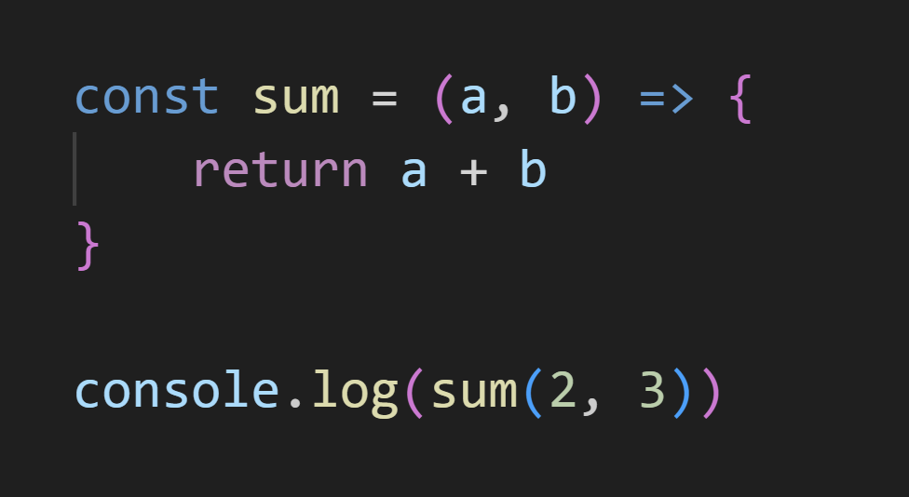
Arrow function
Shorthand to define function in Javascript

Slide 32
forEach(fx)
Loop throught array by calling to function in each loop
`fx` is function which can has parameter (elem, index, arr)
elem: current accessed element
index: current index
arr: array itself

Slide 33
map(fx)
Loop throught array, call passing function then create new array from function result
Parameter is mostly same as forEach()

Slide 34
filter(fx)
Loop throught array, call passing testing function, return new array of element which testing function return TRUE
Parameter is mostly same as forEach()

Slide 35
Quiz
From Input Array [1, 2, 3, 4, 5]
Write code to return array
Return [10, 20, 30, 40, 50]
Return [10, 21, 32, 43, 54]
Return [10, 2, 30, 4, 50]
Return [2, 4]

Slide 36
Object
Construct object
Accessing / Modify object property
Remove object property

Slide 37
Typescript
Javascript + Type + More stuff...
Keyword `interface`
Can test typescript via command line

Slide 38

Basic React

Slide 39
Let’s Start
First, create new project.
npm create vite@latest
Create new project by using typescript.
npm create vite@latest {project-name}-- --template react-ts

Slide 40
Next Step
Go to project and install package.
cd {project-name}
npm install
After that, start project.
npm run dev

Slide 41
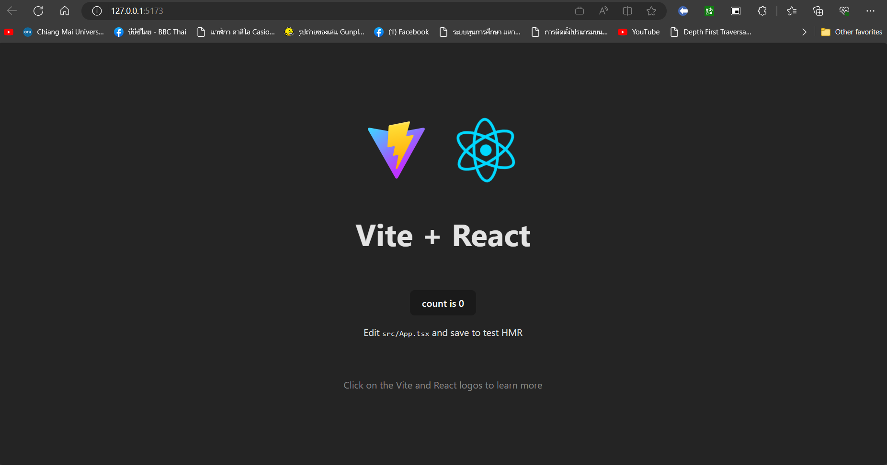
1st time running page from scratch

Slide 42
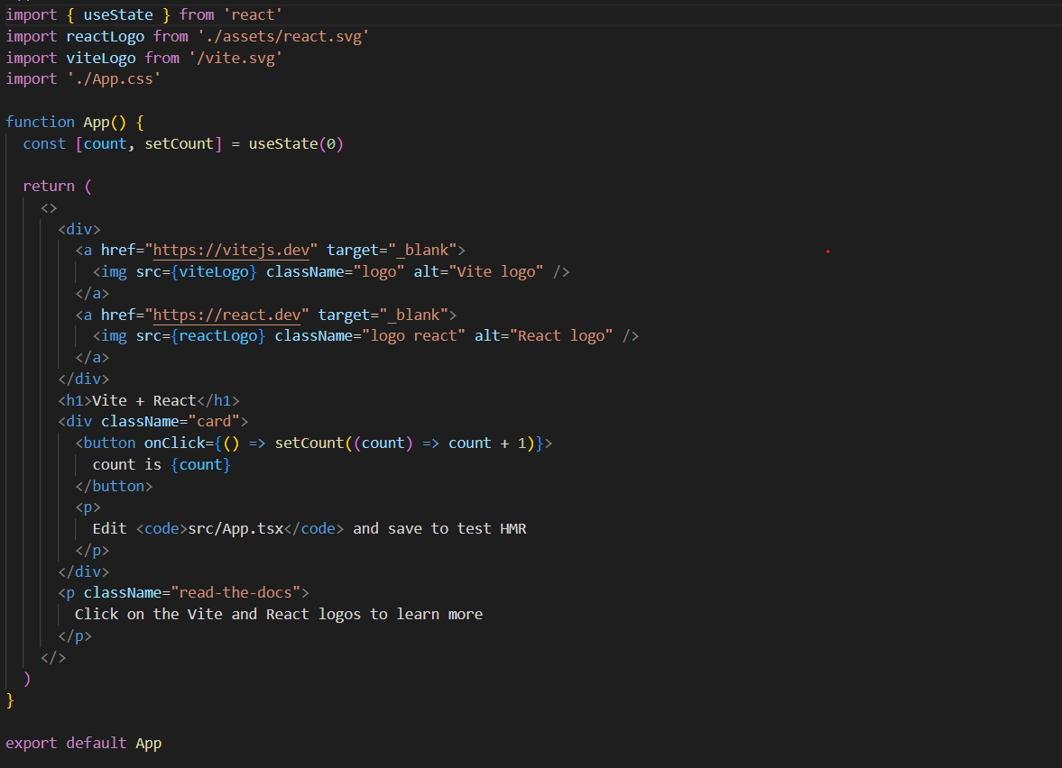
Import library/component/CSS
Function Component
Return HTML Element.

Slide 43
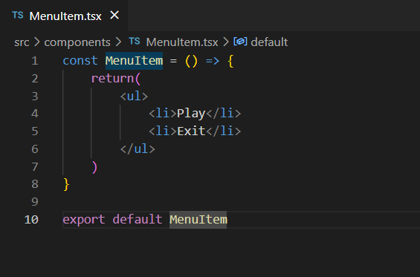
Create new component.

Slide 44
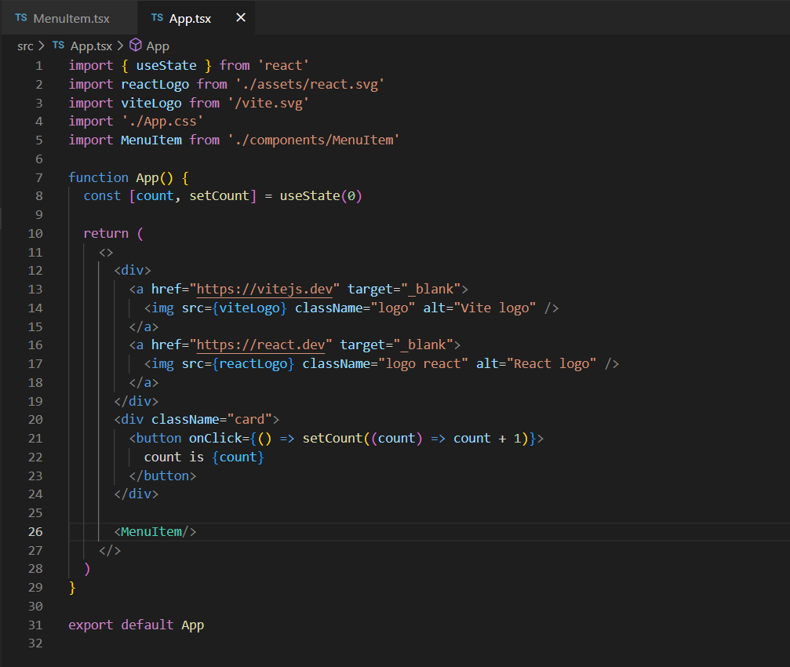
Import and use component.

Slide 45
Parent/Child component.
Parent Component
Child Component

Slide 46
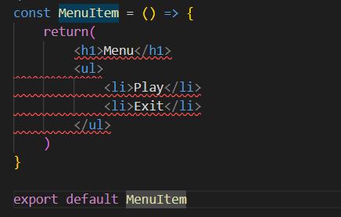
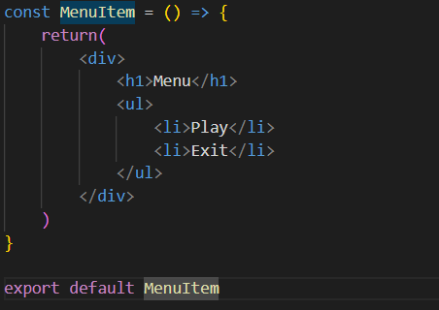
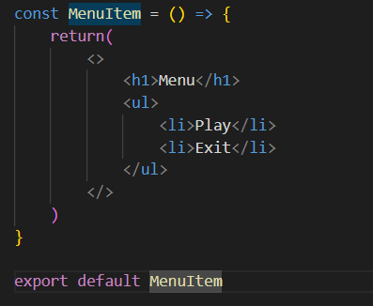




Component.
In one component, it should return only 1 HTML element.
If you need return many HTML element, you should wrap these element by use <div> or <> tag.

Slide 47

How to use CSS in React.
Inline styling
JS object
CSS Stylesheet
CSS modules

Slide 48
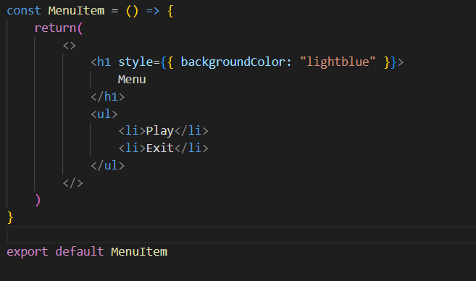
Inline Styling

Slide 49
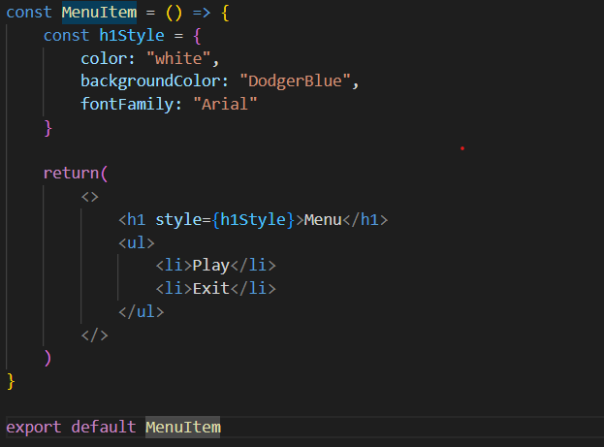
JS Object

Slide 50
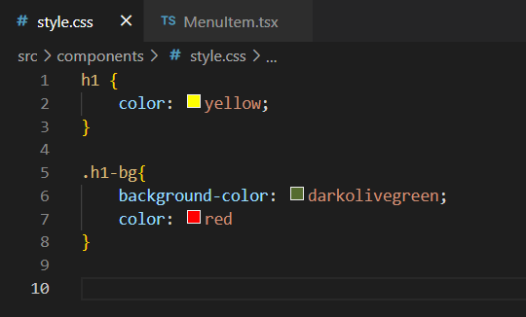
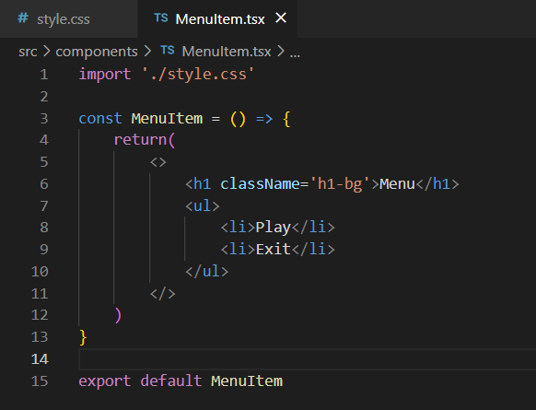
CSS Stylesheet

Slide 51
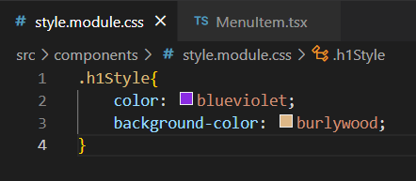
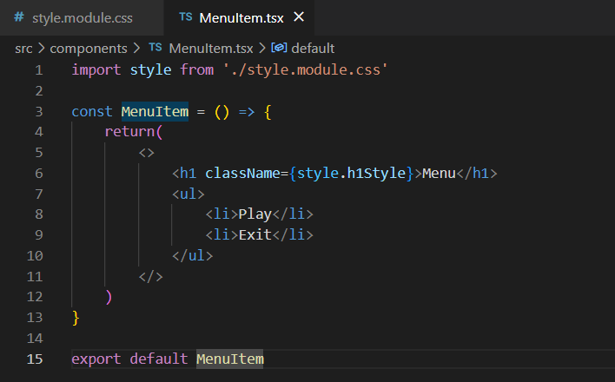
CSS Modules

Slide 52
Example code React app

Slide 53

Nook Section

Slide 54

Before Start
1. Get the example code
Please clone or download the example code from https://github.com/mycostech/react-cs-cmu
2. Open in VS code
Open this folder code in VS code
3. install and run in development mode
Open terminal, hit command npm run install and npm run dev

Slide 55

So, What next?
From now on

Slide 56

Every Section
Focus
Everybody focuses on the demo from me no need to try to write following the demo.
Practice
After demo, we will do a practice, 5 mins
Hint
No worry about codes, I will show all practice answer code in Pull request

Slide 57

Speaker: NOok
Sections
1
Component
2
Props
3
State
4
Event
5
JSON

Slide 58
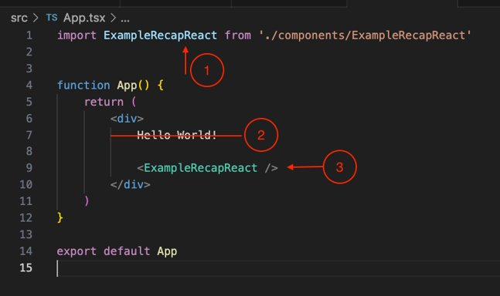
Show component
Good first practice
In App.tsx
STEPS
1. Import a component
2. Remove old string
3. Use the component in App.tsx

Slide 59
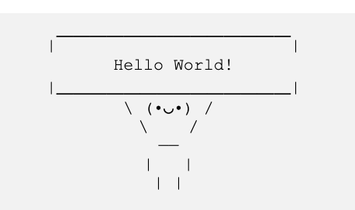
Show be like

Slide 60
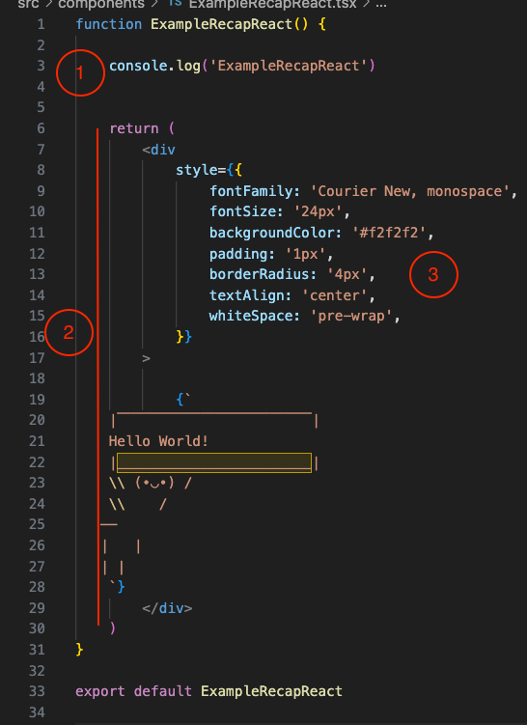
Recaps
1
Statement code, procedure section
2
JSX syntax, after return
3
Inline style

Slide 61
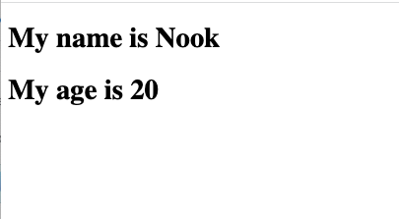
Challenge: Show your name and age
Step 1
Create a component name: ShowNameAndAge.tsx
Step 2
Show name and age, can use any html tag
Step 3
Import this component and use in App.tsx

Slide 62

Tips
Naming
Naming a component and file names with Capitalize, Pascal Case
Default Export
We can name any import component from Export default but usually use the same name.
Less is Good
Prefer many components, one component does one thing, better than many lines of codes

Slide 63
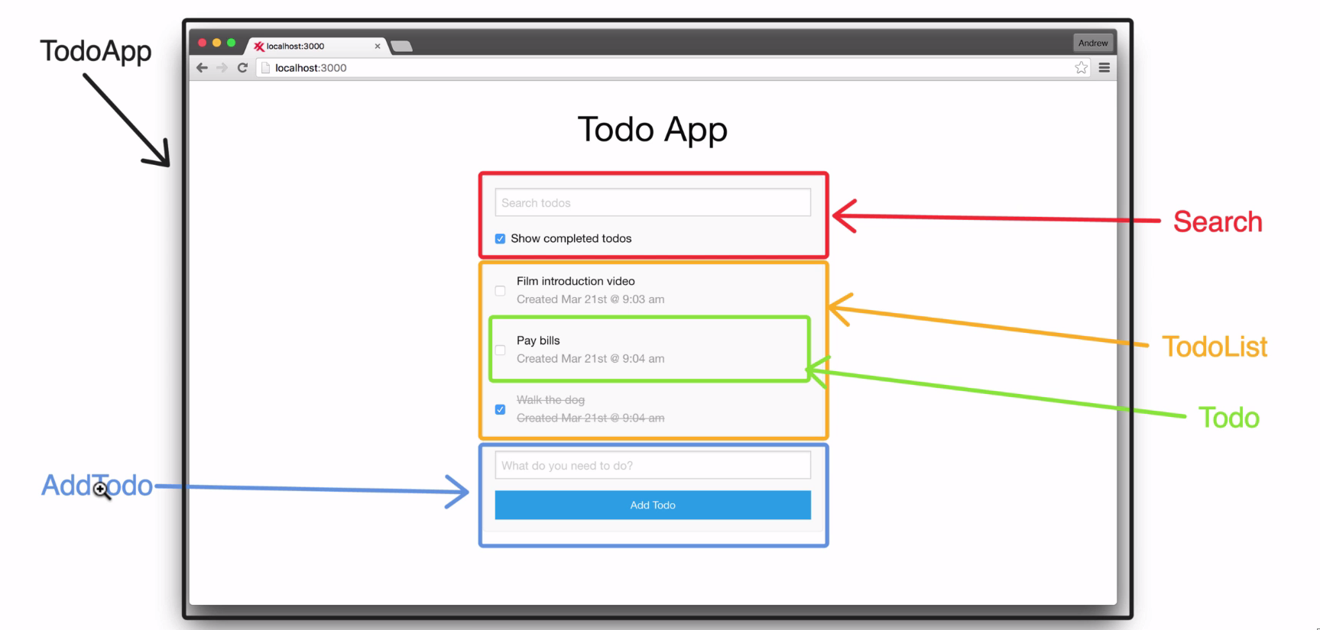
React: World of Components

Slide 64
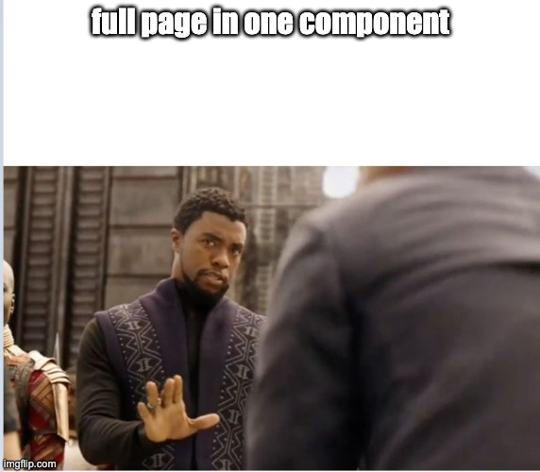
React: World of Components

Slide 65
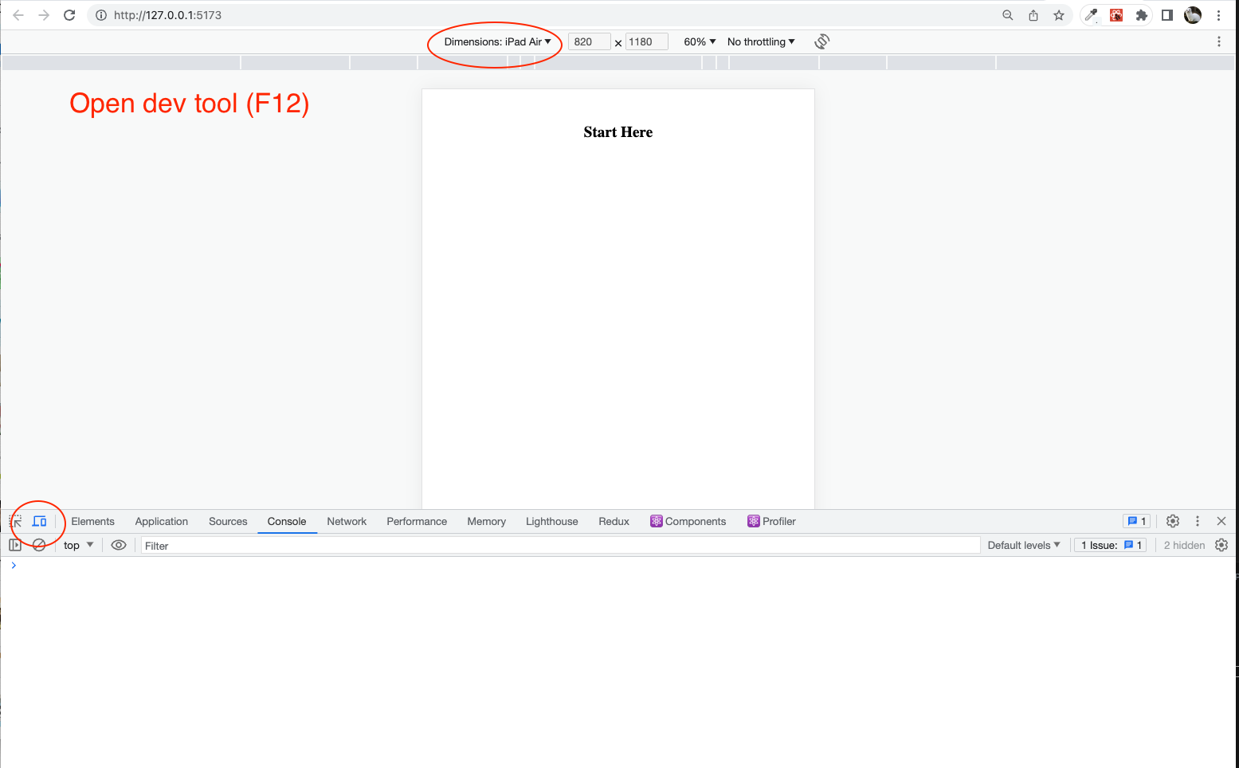
Web Screen Size?

Slide 66

Default breakpoints
Each breakpoint (a key) matches with a fixed screen width (a value):
xs, extra-small: 0px
sm, small: 600px
md, medium: 900px
lg, large: 1200px
xl, extra-large: 1536px

Slide 67
Our Best component design Framework
https://mui.com

Slide 68
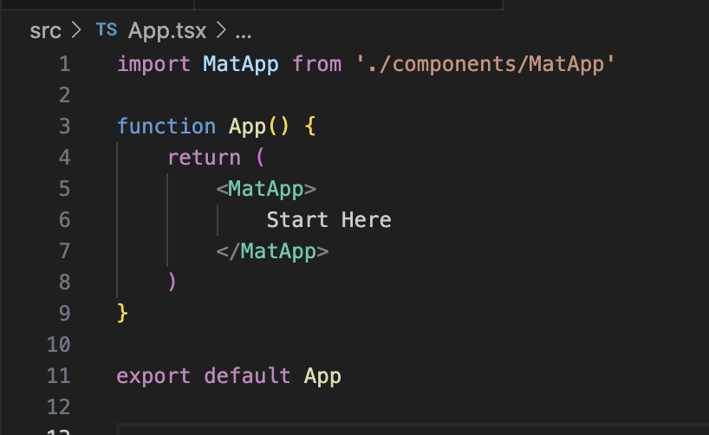
Start Material App

Slide 69
Design System:
Grid?

Slide 70
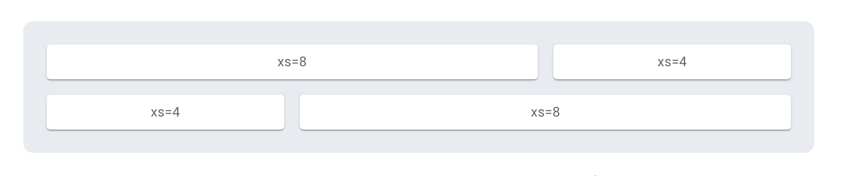
Basic grid
Column widths are integer values between 1 and 12; they apply at any breakpoint and indicate how many columns are occupied by the component.

Slide 71
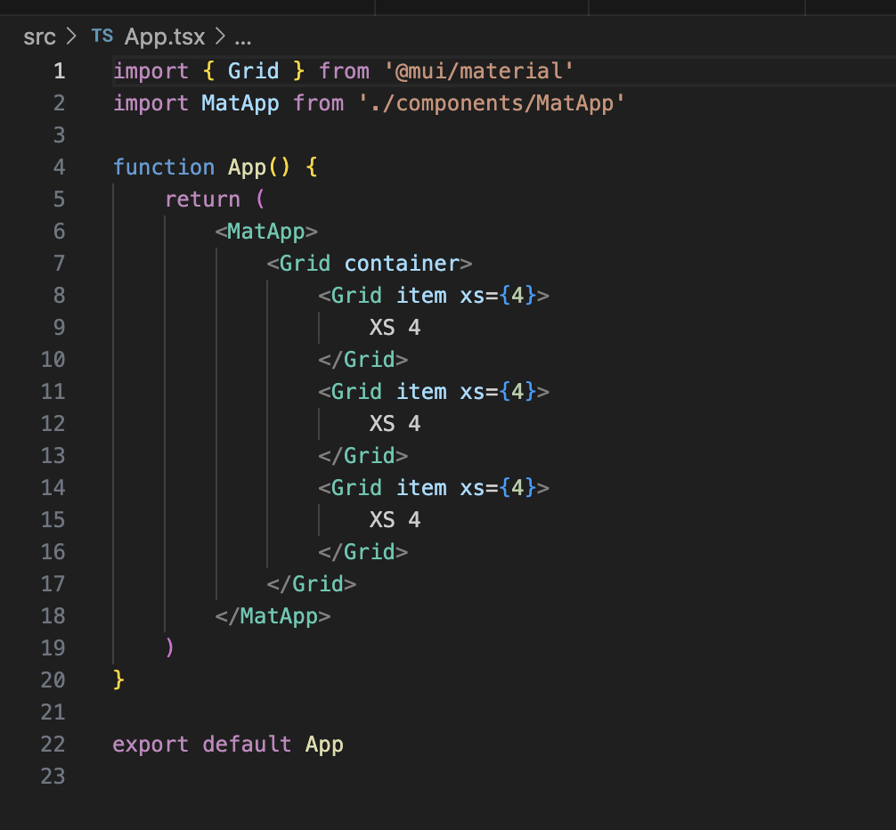
Basic grid
Responsive?

Slide 72

Section Two: Props
Short for
Rule
properties
cannot be changed
What is Props
"props" are a way to pass data from parent to child components.

Slide 73
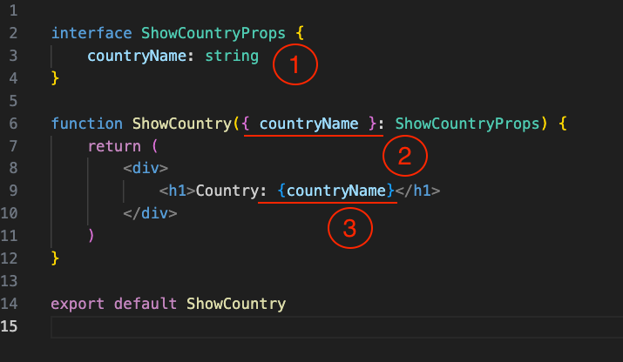
Example passing Props
1
Declare interface of component
2
Declare a variable for use in component
3
Use the countryName in JSX

Slide 74
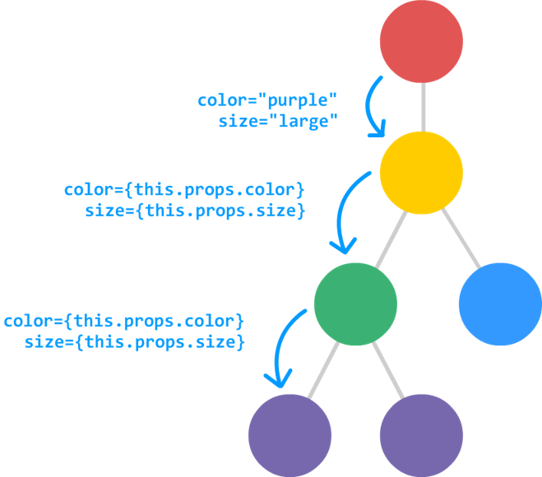
harder example
Section Two: Props

Slide 75

Challenge
Step 1
Back to use ShowNameAndAge component
Step 2
Create an interface and make Name and Age to be props
Step 3
passing name and age via App.tsx

Slide 76
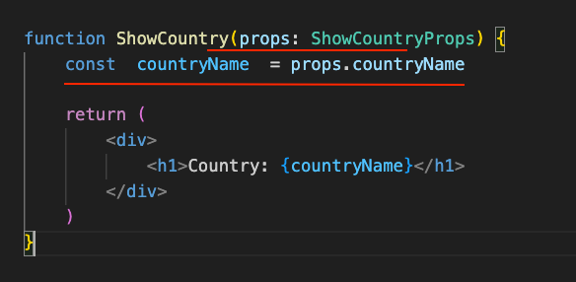
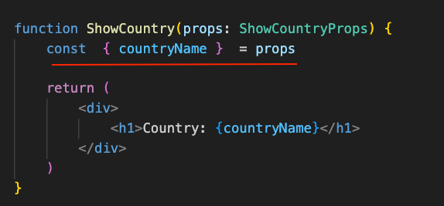
Tips:
Declare variable from props
Old style
Modern
From props, we declare countryName and get data from props.countryName
Object destructuring syntax in JavaScript. It allows you to extract specific properties from an object and assign them to variables with the same name.

Slide 77
Hard to naming interface?
Tips
Name exactly with component + Props
“ShowCountryProps”
Hard to type?
We can use any type to bypass TS error but don’t recommend.
“name: any”
Naming props
usually name with camel Case that first start will be lowercase.

Slide 78
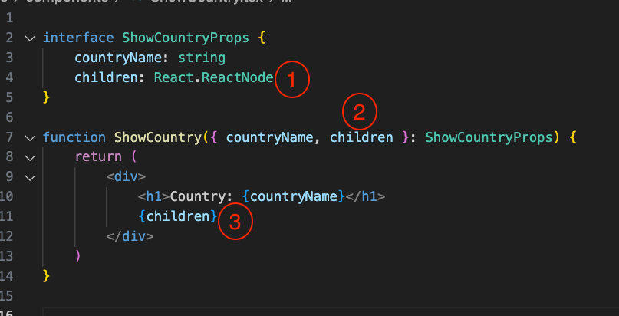
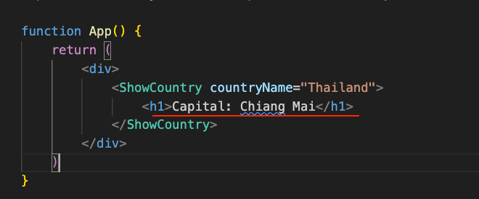
Special Props
Children props
It represents the content enclosed between a component’s opening and closing tags when used in JSX. It allows you to pass complex content, such as other components, text, or elements, to a component and access it within the component using props.children.

Slide 79
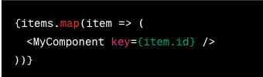
Special Props: Key
Key props,
The key prop is used when rendering a list of components in React. It is a special prop that helps React identify each component uniquely in a list. The key prop should be assigned a unique value for each component within a list. React uses the key prop to efficiently update and reorder the list when necessary. It is recommended to use a unique identifier, such as an ID or a unique attribute, as the value of the key prop.

Slide 80


Slide 81
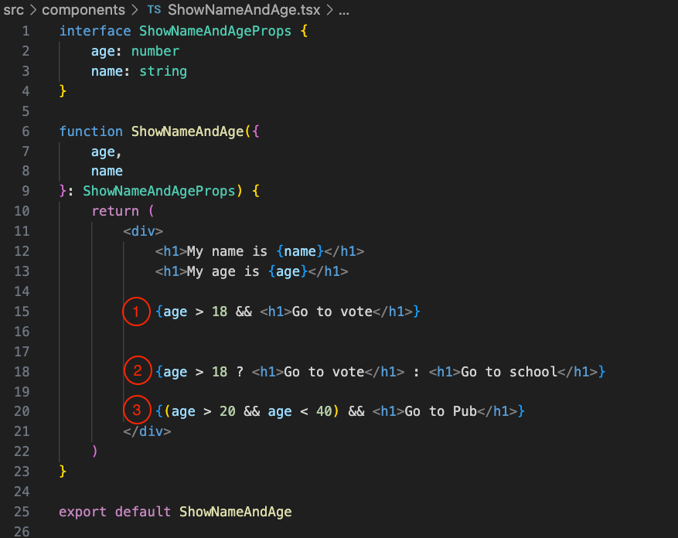
Before next section, Condition in JSX
1
IF, one condition no else
2
IF – ELSE, condition
3
IF, Multiple condition && = and, || =or

